Slide 1
Simple Lost & Found GUI using Java Swing

Slide 2
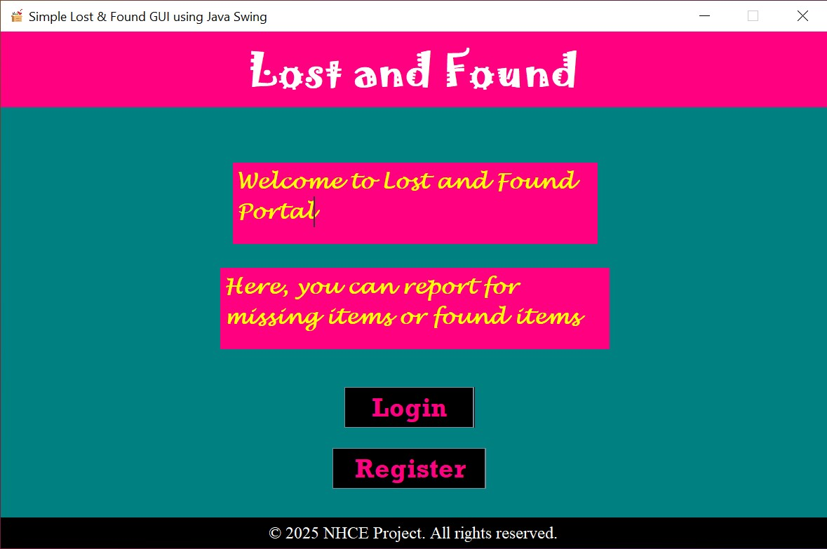
MainPage
Navigating the future

Slide 3
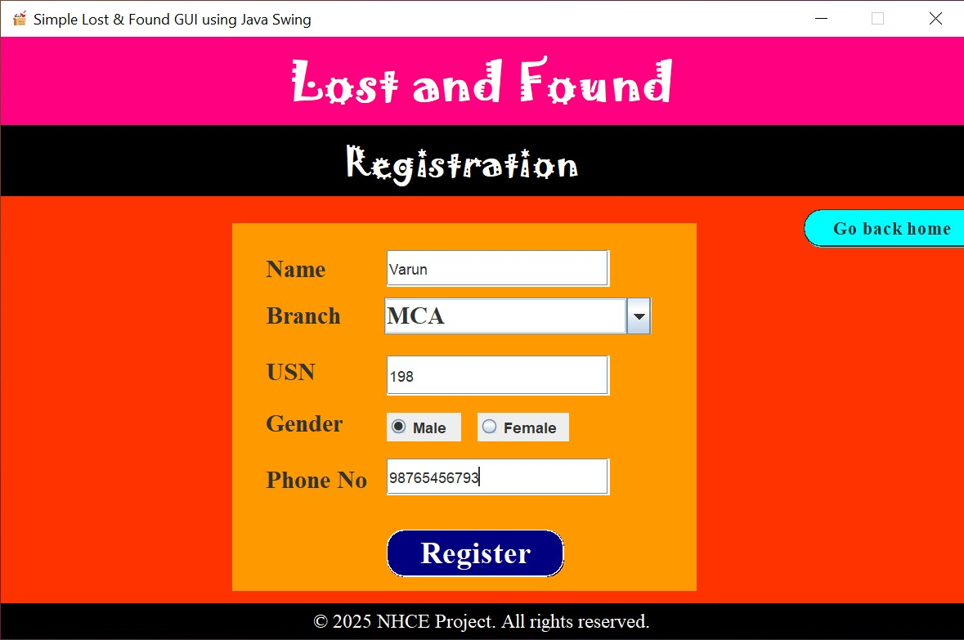
Registration page

Slide 4
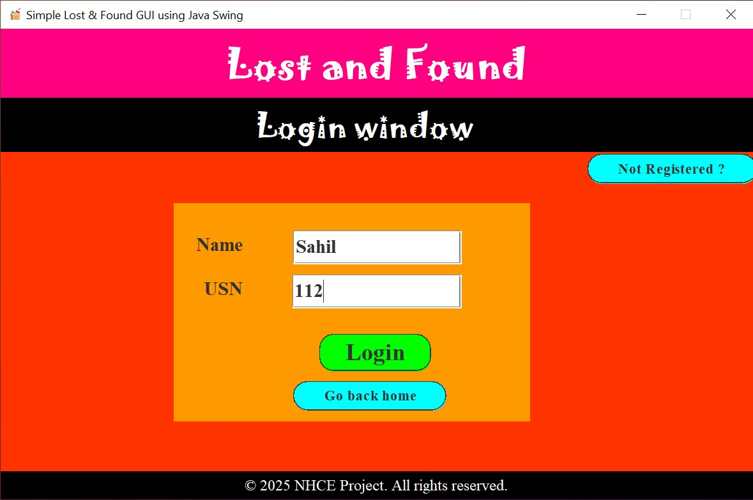

Login Page
Unlocking new horizons

Slide 5
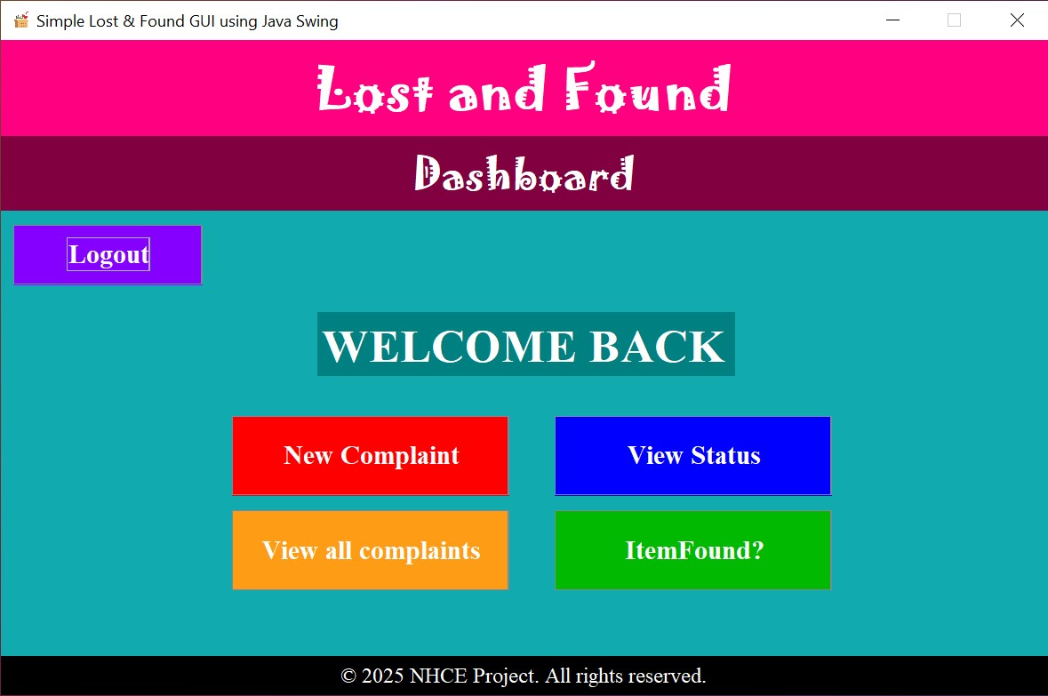
User Dashboard

Slide 6
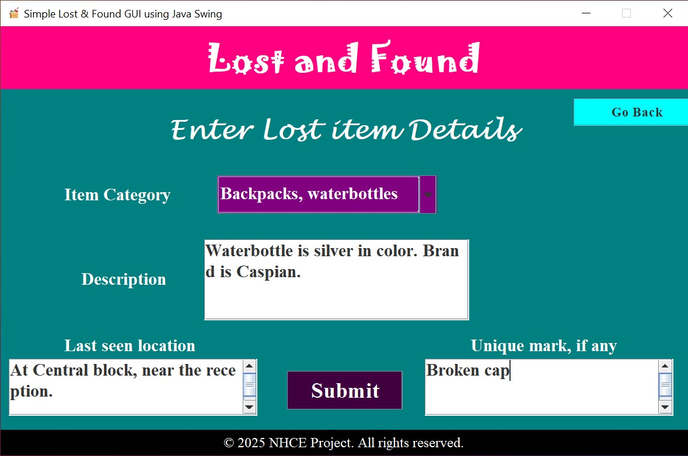

New Complaint

Slide 7
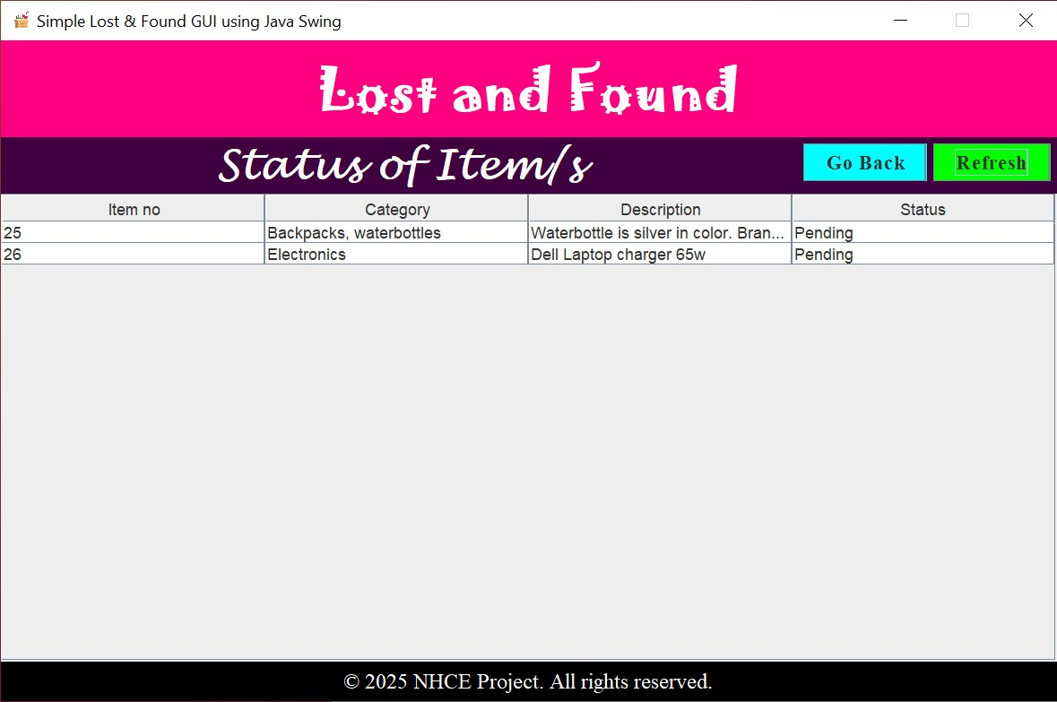
Pending Complaints

Slide 8
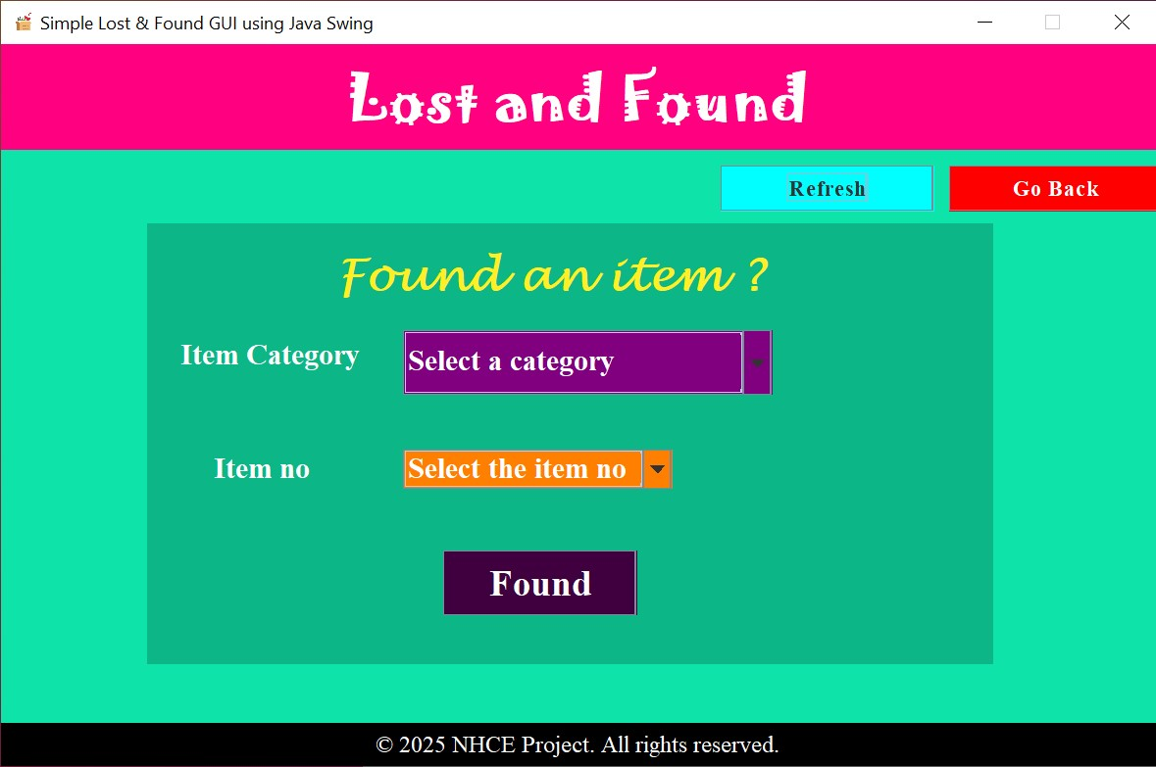
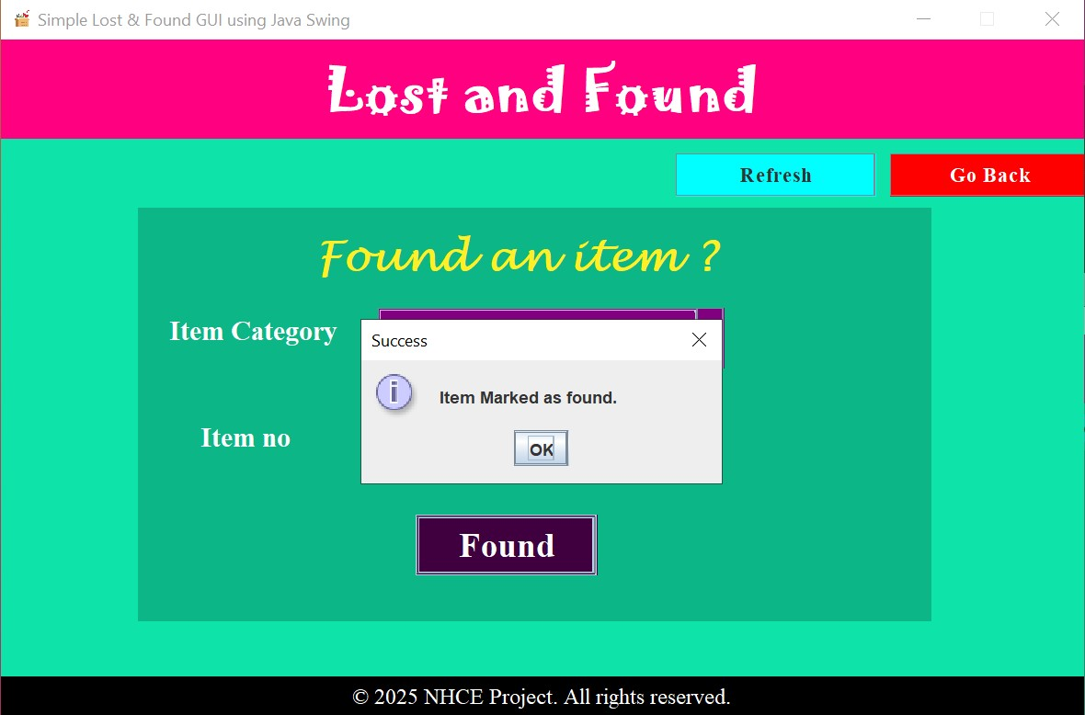
Self Found ?

Slide 9
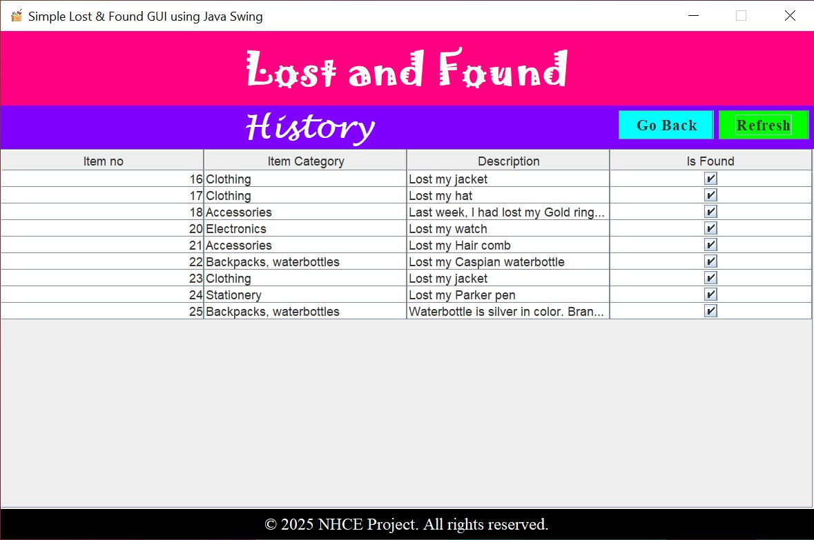
Found Items

Slide 10
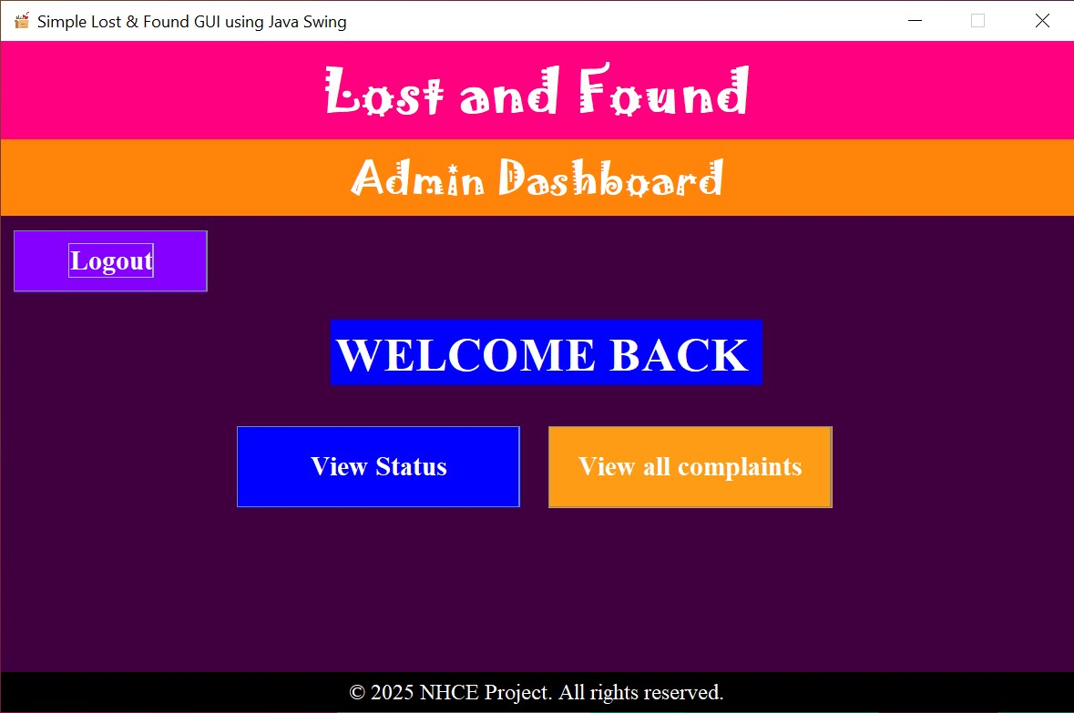

Slide 11
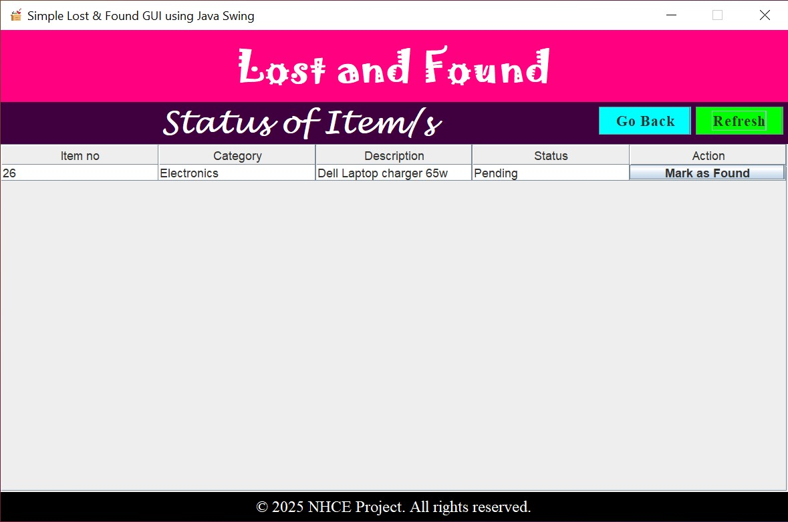
Admin Action

Slide 12
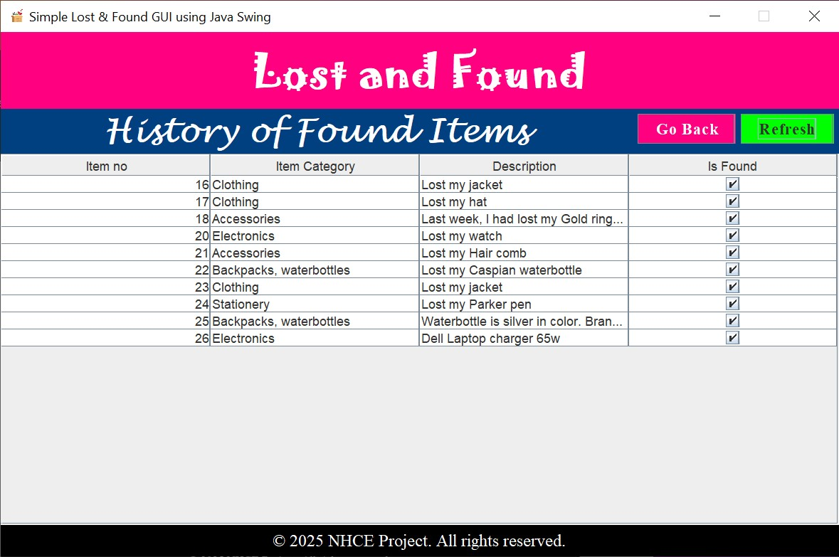

Slide 13
Future Perspective
Make a full-fledged React JS application
Add Cloud support
Donate to Colleges, Schools, Corporate firms, etc.
Product enhancement.
  Introduce regular updates and features to enhance product offerings.
Technology integration.
  Explore emerging technologies for potential integration into our operations.

Slide 14
Thank You
Team Members
Ranjitha Sriram Nigale
1NH24MC106
Sahil Rajesh
1NH24MC112

